Slide 1
Erasmus+ Latvia 2023

Slide 2
FUN, WEEKEND TRIPS AND FREE TIME ACTIVITIES

Slide 3
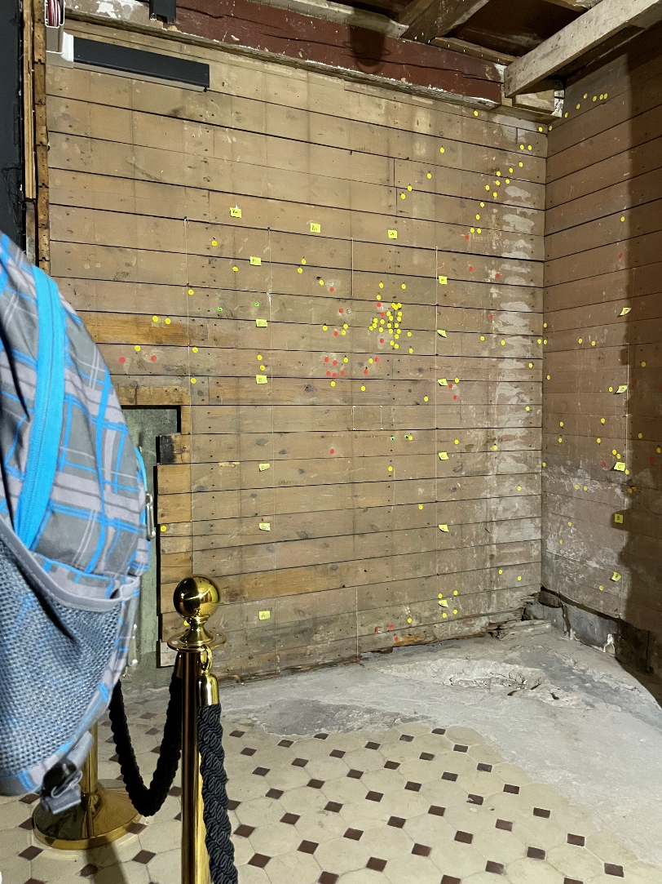
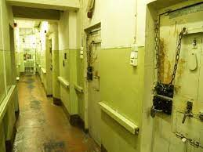
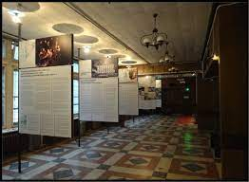
KGB Museum
The Corner House is a historic building in the city center of Riga, Latvia.
It was known as the headquarters of the Soviet KGB in Latvia from 1940 to 1941 and from 1944 to 1991.
Execution wall

Slide 4
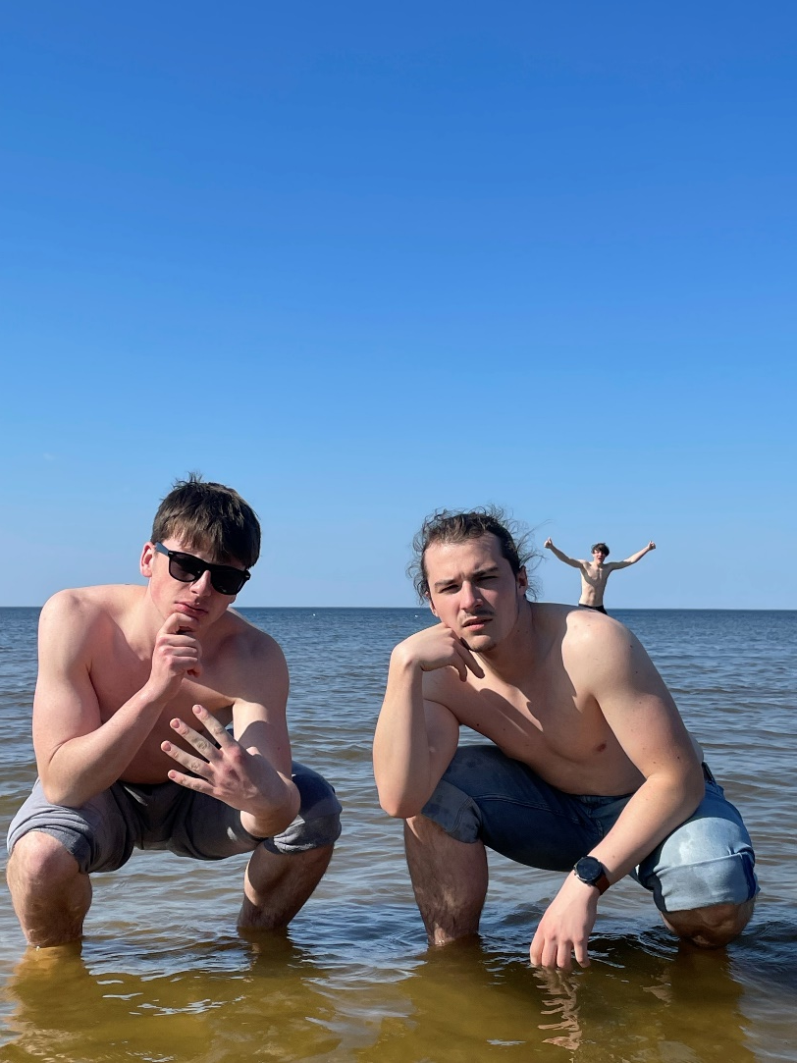
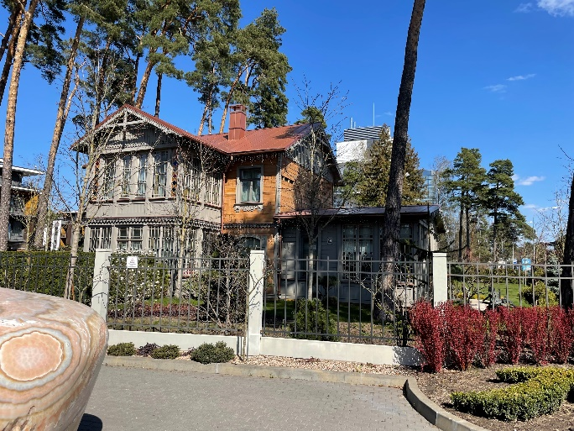
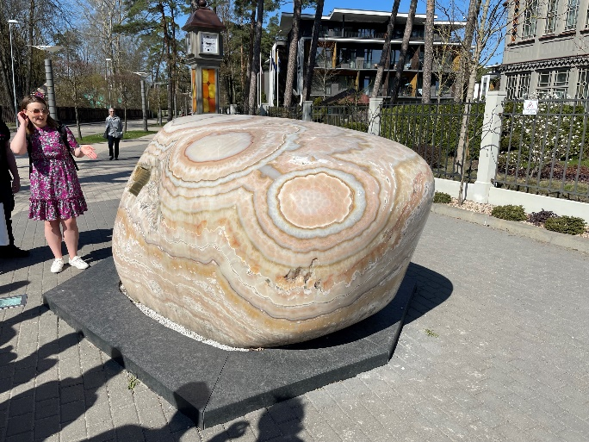
Jurmala
Jūrmala is a resort town in Latvia, about 25 kilometres (16 miles) west of Riga.
Jūrmala is 32 km (20 miles) long and sandwiched between the Gulf of Riga and the Lielupe River.

Slide 5
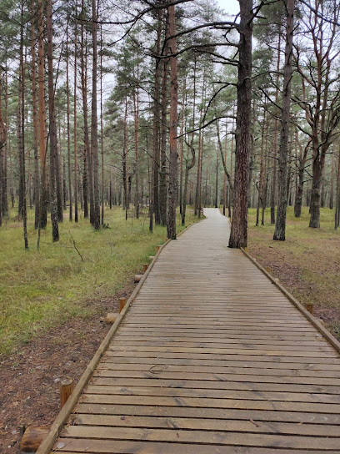
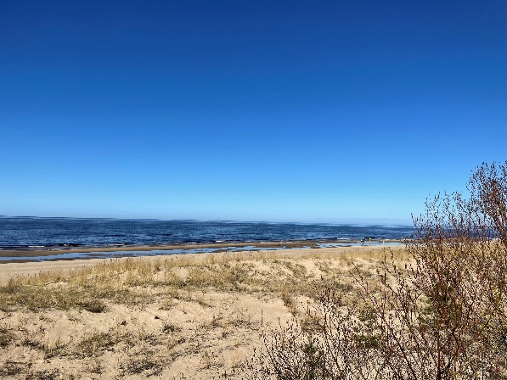
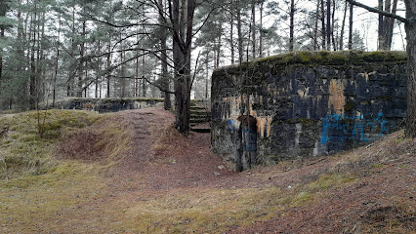
Vacaku beach
Vecāķi Beach is one of the most beautiful and popular beaches in Riga.
It is located by the Baltic Sea and is about 3 kilometers long.
Many Soviet-era bunkers are located in this area.

Slide 6
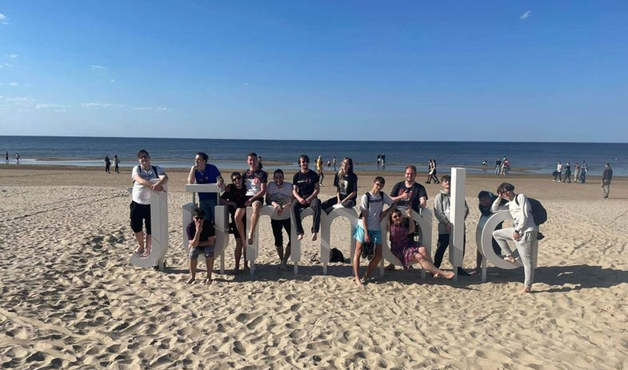

Slide 7
Project Key Take-aways
TEAMWORK
CONFIDENCE
RELIABILITY AT WORK
RESPONSIBILITY FOR JOB DONE
FOREIGN CAPITAL CITY EXPERIENCE
COURAGE TO TALK IN FRONT OF OTHER PEOPLE
INDEPENDENCE

